Slide 1




Smart Traffic Management Using Deep Learning
Team Id- 6451
Rahul K Shah
Adil Tansawala
Smit Patel
Vedanshu Sharma
Nishant Prajapati
Notes:
1

Slide 2

Project Objectives
Problem Statement
Project Overview – Introduction
End Users
Wow Factor in Project
Modelling/Block Diagram/Flow of Project
Result/outcomes
Conclusion
Future Perspective

Slide 3
Problem Statement
Revolutionize traditional traffic management with an advanced system integrating deep learning object detection and real-time analysis. The project addresses the pressing need for efficient traffic management systems capable of mitigating congestion and ensuring smoother commuting experiences.

Slide 4
Project overview - Introduction
Urbanization and population growth have led to unprecedented challenges in managing traffic flow effectively. Conventional approaches to traffic management rely on static rules and infrastructure, which often result in inefficiencies and congestion, leading to wasted time and resources. To address these challenges, our project leverages advanced technologies to develop a dynamic and adaptive traffic management system.

Slide 5


Technical Dilemma
Vs

Slide 6
End User
Traffic authorities and city planners responsible for managing roadways and ensuring efficient traffic flow.
Commuters and drivers seeking smoother and safer travel experiences on urban roads.
Emergency service providers requiring swift and unobstructed access to incidents and accidents.
Urban planners and policymakers interested in leveraging technology to improve transportation infrastructure and city planning.

Slide 7
Our proposed solution
To overcome all this issues in traditional crowdfunding applications, we are hereby providing our solution with key features like:
Real-time Object Detection! Implementing deep learning models for real-time vehicle detection within traffic streams.
Dynamic Traffic Flow Optimization! Utilizing data analysis to predict and adjust traffic patterns for enhanced efficiency.
Intelligent Token Passing Mechanism! Employing a token-based system to prioritize vehicle flow, especially for emergency vehicles.

Slide 8

Wow Factor in Solution
Cutting-edge tech: Deep learning algorithms analyze real-time traffic data for optimal flow.
Safety first: Proactive measures prevent accidents, ensuring safer journeys.
Smooth rides: Dynamic adjustments minimize delays, reducing travel times.
Eco-friendly: Efficient management lowers fuel consumption and emissions.
Global solution: Addresses urban congestion for smoother, safer, and sustainable cities.

Slide 9
OUR GOAL
We chose this project to address and overcome all the issues with traditional crowdfunding applications like :
Alleviate congestion by optimizing traffic flow and reducing travel times.
Enhance safety measures to minimize road accidents and ensure safer roadways.
Embrace technological solutions to develop smarter traffic management systems for modern urban environments.
Improve commuting efficiency by optimizing travel routes and reducing congestion-related delays.

Slide 10
Code & Implementation

Slide 11
Working
Initial
Function
Result
There are 4 lanes:
1ˢᵗ lane is open
2ⁿᵈ assigned X sec timer
3ʳᵈ assigned STOP
4ᵗʰ assigned STOP
When 1ˢᵗ lane opens and it will trigger function which will analyse traffic of 2ⁿᵈ lane ,Using open CV and STOP lane.
This function will return value X’ which will assign to 3ʳᵈ lane timer & Repeat.
Function- Assign time (sec) according to vehicle spotted .
Min-max value to avoid assigning insufficient time.
Reduce unnecessary time.
No other costs Requirement—Full Time camera feed for Machine Learning real time traffic analyzing.

Slide 12


The Coding Part
Different languages we used in our project and why did we chose those technologies :
Python
YOLO
Open CV
Versatile
Real Time Object Detection
Computer vision tools
Readable
Timely detection of vehicles
image processing
Scalable
System efficiency
video analysis
Community-driven
Adaptive
traffic management algorithms

Slide 13

Implementation and Deployment
Collaboration with local authorities and traffic agencies.
Installation of cameras at strategic locations.
Integration with existing traffic management infrastructure.
Educating user for new system, analysis and benefits

Slide 14
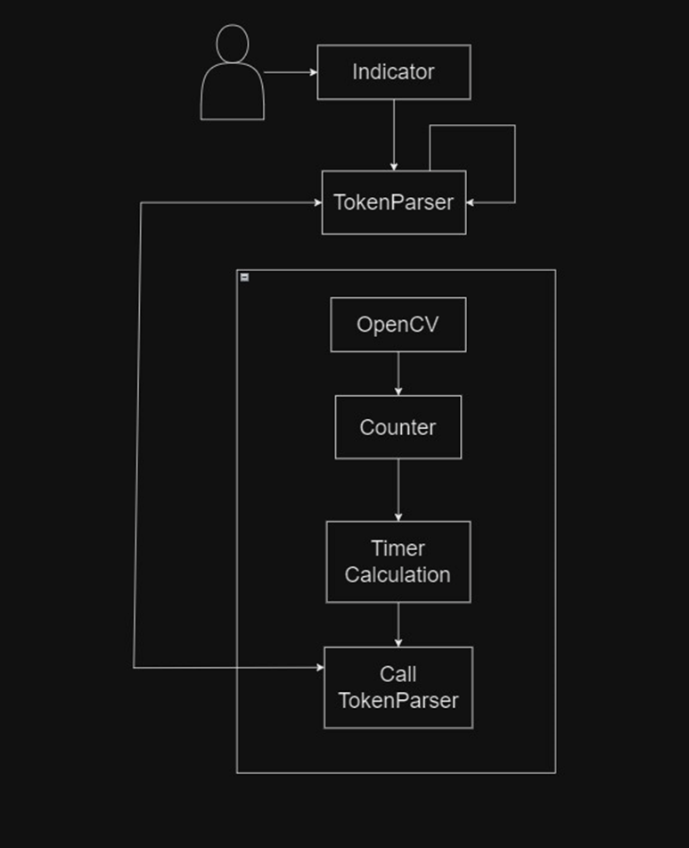
Modelling

Slide 15
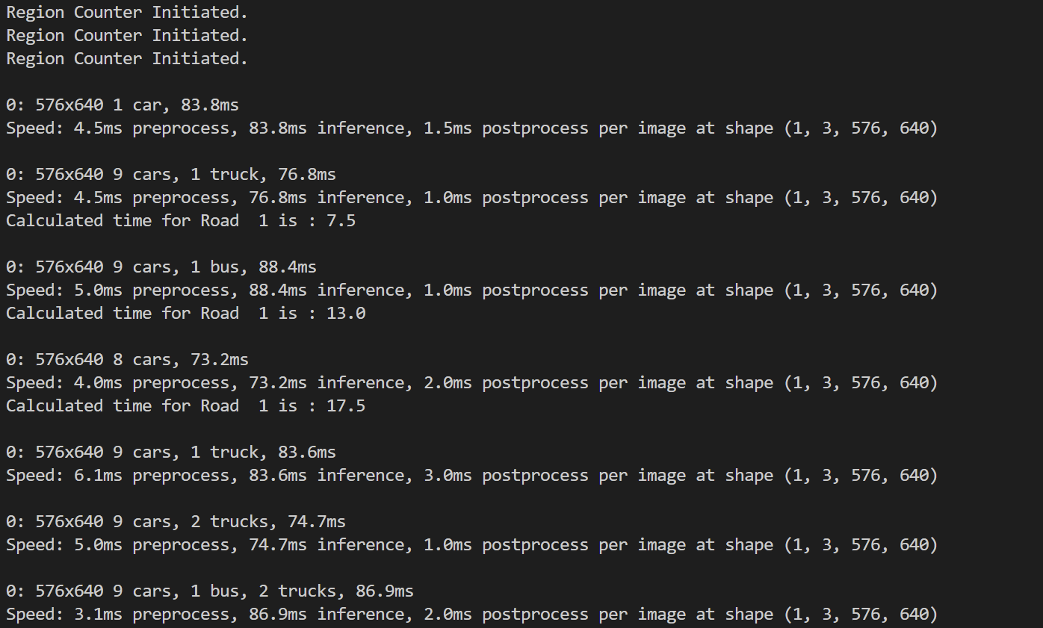
Result / Outcomes

Slide 16
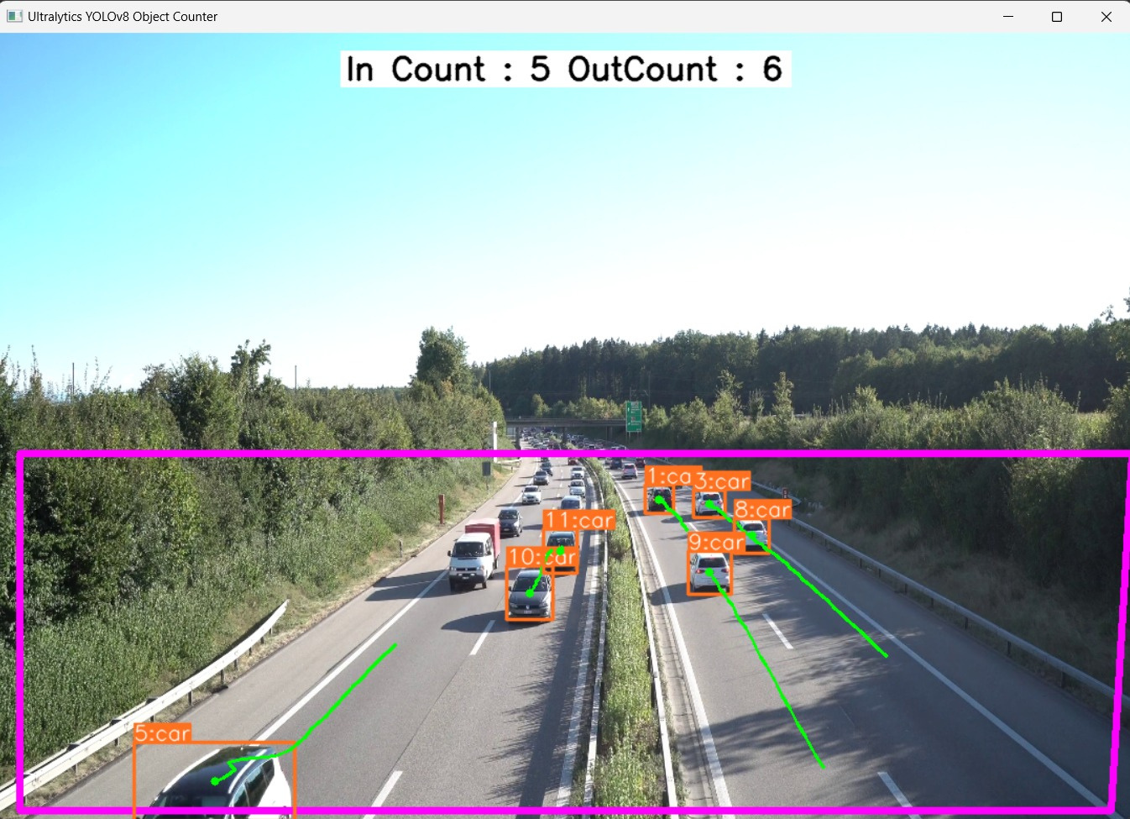

Slide 17
Future Perspective
There are two implementation which we are seeking and thinking to add upon which are as follows:
AMBULANCE SAFETY: Here , in this project, we can only detect the first three - four rows so depending upon that we seek to increase the detection area so that the ambulance can easily be detected and pass the signal and the life can be saved.
SPEED Detection and chalan : It will detect and send warning for over speeding and if user exceeds limit of warning it will generate E-chalan for registered vehicle

Slide 18
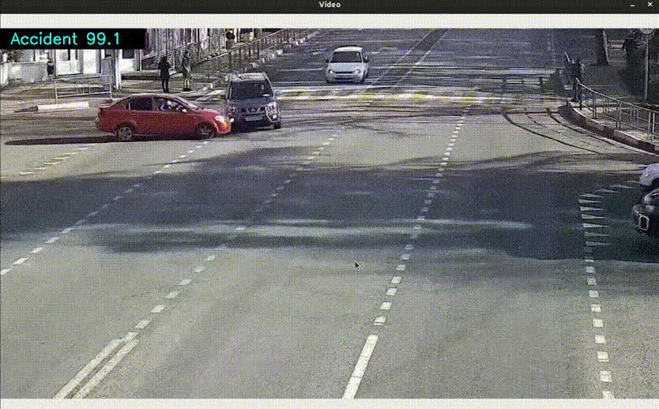

Slide 19
Conclusion
In conclusion, developing this innovative traffic management system has been an exhilarating journey.
We trust that our efforts will significantly impact road efficiency and safety, and we're excited to witness the positive transformations.
Thank you for joining us on this remarkable journey, and we eagerly anticipate the continued evolution and success of our traffic management solution.

Slide 20
Thank you...!
Notes:
11

